Slide 1

Recommending best city in Canada for Clothing business by a foreign investor

Slide 2
Introduction
A Foreign Investor (customer) wishes to invest and open a Clothing Store Business in one of the Canada’s big cities. He has a concept but as a foreigner, new in the country with little idea about Canada’s City structure and therefore requires help.
He already owns a middle range Clothing Store Chain in the United Kingdom and this will be the first Store opened in Canada, therefore, it should meet some criteria to present his brand correctly.

Slide 3
Objectives
According to Investors’ demand, Clothing business must;
Opened in one of the big Cities in Canada (Population over 100.000 and more).
Within the max. 15 minutes walking distance from the Geographical coordinates of the City Centre.
As far away from other Clothing Stores as possible.
As close as possible to Italian Restaurants..
As close as possible to Hotels.
He added also, a city with highest possible unemployment rate would be an advantage for him, as finding personal in a short time.
Population of the city also counts as a positive measure too. (City should be as crowded as possible).

Slide 4
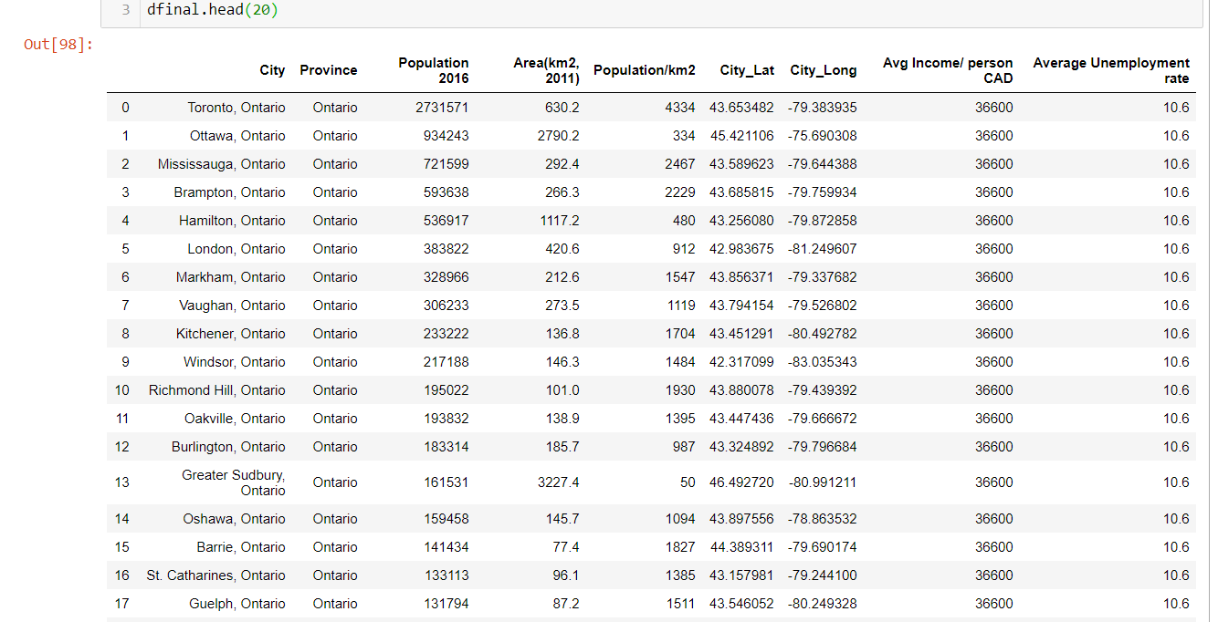
Data
To perform this analysis, we will need the following data. These data were collated from Wikipedia and Statistics Canada, the Canadian government official statistics website https://www.statcan.gc.ca.
1. General Venues data of all Major Cities in Canada.
2. Some Socioeconomic information such as Population, Average Income /person, Average Unemployment Rate and Area in km2 of that city.
3. Top venues in that city obtained from Foursquare API..

Slide 5
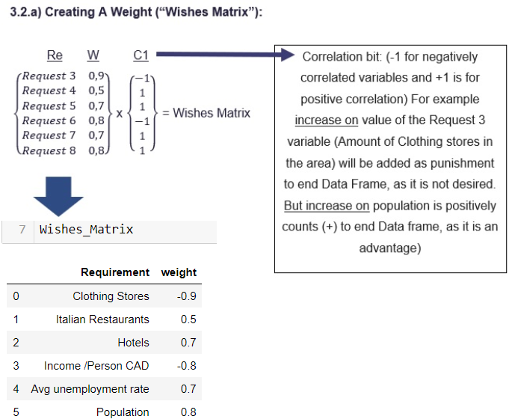
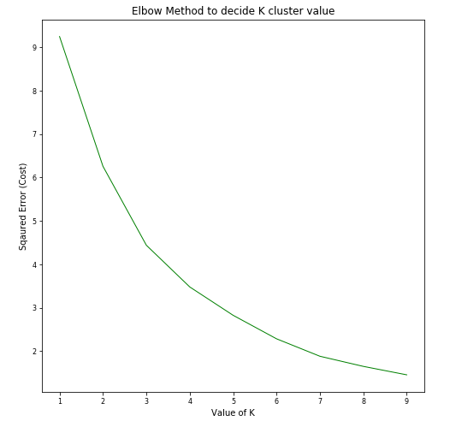
Approach
Convert Investor requirements to Wishes Matrix.
Data Cleaning, Normalization and Exploratory Data Analysis.
Using Foursquare API to obtain Venues and Venue Locations in Cities.
Obtain a Total_Score parameter for each City as similarity parameter to Investor requirement.
Clustering Analysis using K-Means Unsupervised Machine Learning Algorithm to find best City.
Evalution of Clustering Analysis for optimum K.
Visualize the Cities using folium library(python)
Optimal K = 4

Slide 6
Results

Slide 8
Cluster Analysis

Slide 11
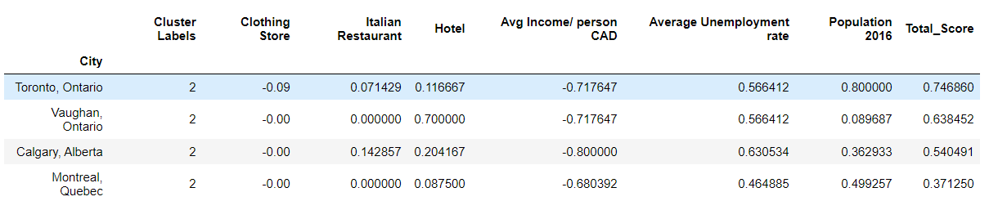
Best Cluster :
The most recommended venues come from cluster 2

Slide 12
What could be done better?
Foursquare doesn't represent the full picture, since many venues are not on the list. For that reason, another map could be utilized such as Google map or Openstreet map.
Locations have too complex geometry, thus defining the closest venues within the certain radius brings additional error to our analysis.

Slide 13
Conclusion
Toronto, Vaughan and Calgary were chosen as the most attractive Cities for investment according to investors demands.
These cities also showed the highest total score above 50% with Montreal dropped since it scores is lower.

